Slide 1

Harvesting Spanish Airport information
Mafalda Gonzaléz Gonzaléz
Brad McKenzie

Slide 2







The goal – harvest some planes (data)!
Scrape all aena airport codes for search table
Prepare aena flight info page for next 6hrs of flights
Retrieve all information
Loop through search table for each AENA TABLE
Final output: all upcoming flights in spain table.
Notes:
1. Intro i.e. what we did (AENA -> 1 airport flight info -> scrape all information) [THIS IS THE BEST SLIDE]

Slide 3




Rselenium to prepare the page
input airport name
Retrieve hour and minute then adjust end search
Retrieve calendar details and set end time
Update search
Expand page search
Notes:
2. Rselenium process (like 2 second explainer because I'll go to vid)

Slide 4
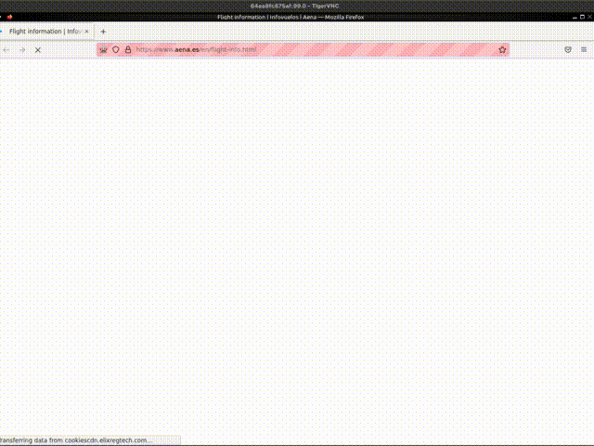
... Easier to see
Notes:
3. Show video of it running and explain it

Slide 5

Defensible coding
Preventing crashes with:
Check in-scope flights exist
Dynamic time and hour search
Running the program at calendar change times:
after 6pm on the last day of the month
Between midnight and 2am due to inconsistency in search/real time
Known limitations
Notes:
~ there's a slide on defensible code and limitations I feel like I could speak to for like 20 seconds if we have time, but otherwise we can skip

Slide 6




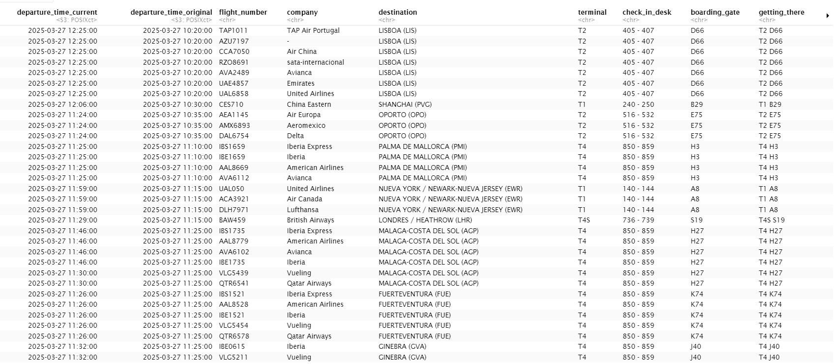
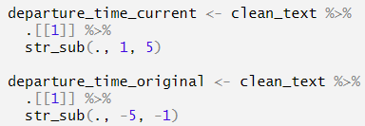
Scrape static HTMLs
FIND TABLE out of HTML
Scrape info for one row
! ReGex instead of Xpath
Iterate through all rows
GENErate Delay and status info of flights
! Midnight cross-over fix
“unique” the flights
Notes:
Find table: nodes, children, Xpath
Scrape information out of one row
Iterate for all rows
Delay and status of flights
Unique information

Slide 7
Scrape static HTMLs
FIND TABLE out of HTML
Scrape info for one row
! ReGex instead of Xpath
Iterate through all rows
GENErate Delay and status info of flights
! Midnight cross-over fix
“unique” the flights
Notes:
Find table: nodes, children, Xpath
Scrape information out of one row
Iterate for all rows
Delay and status of flights
Unique information

Slide 8
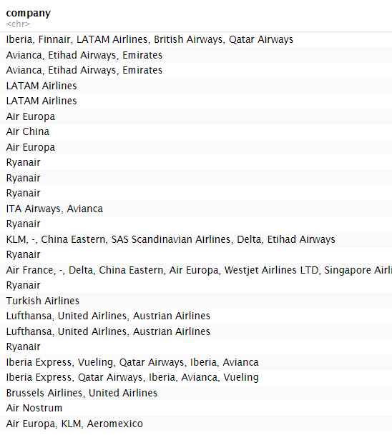
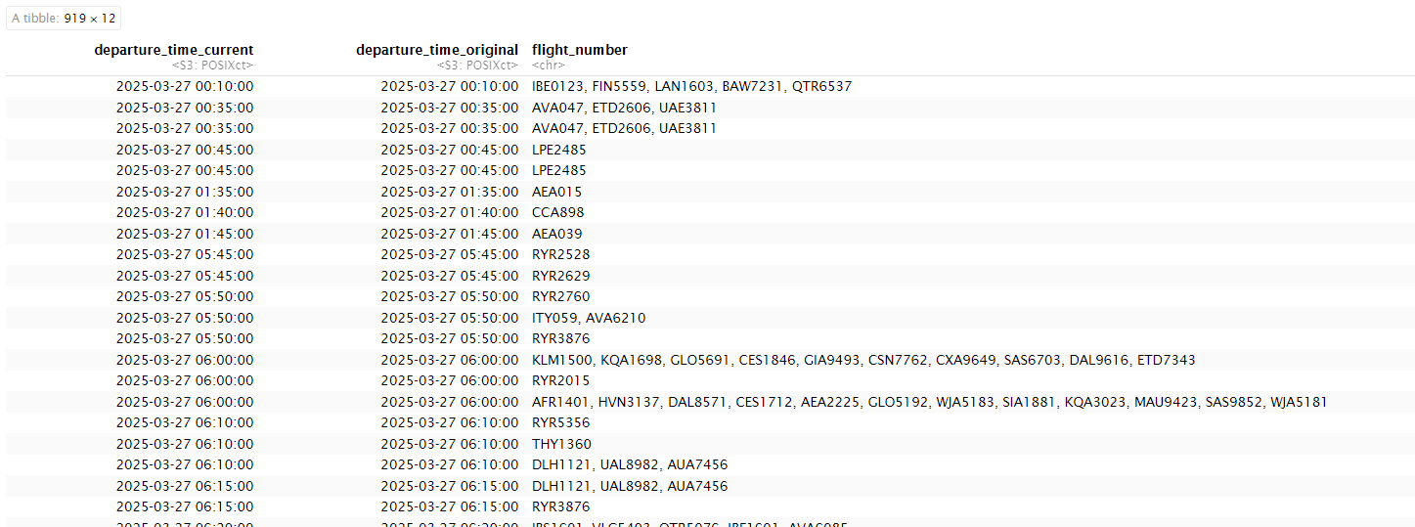
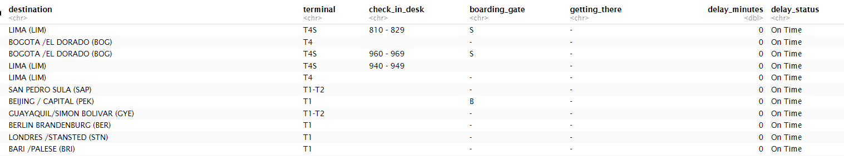
Scrape static HTMLs
Notes:
Find table: nodes, children, Xpath
Scrape information out of one row
Iterate for all rows
Delay and status of flights
Unique information

Slide 9
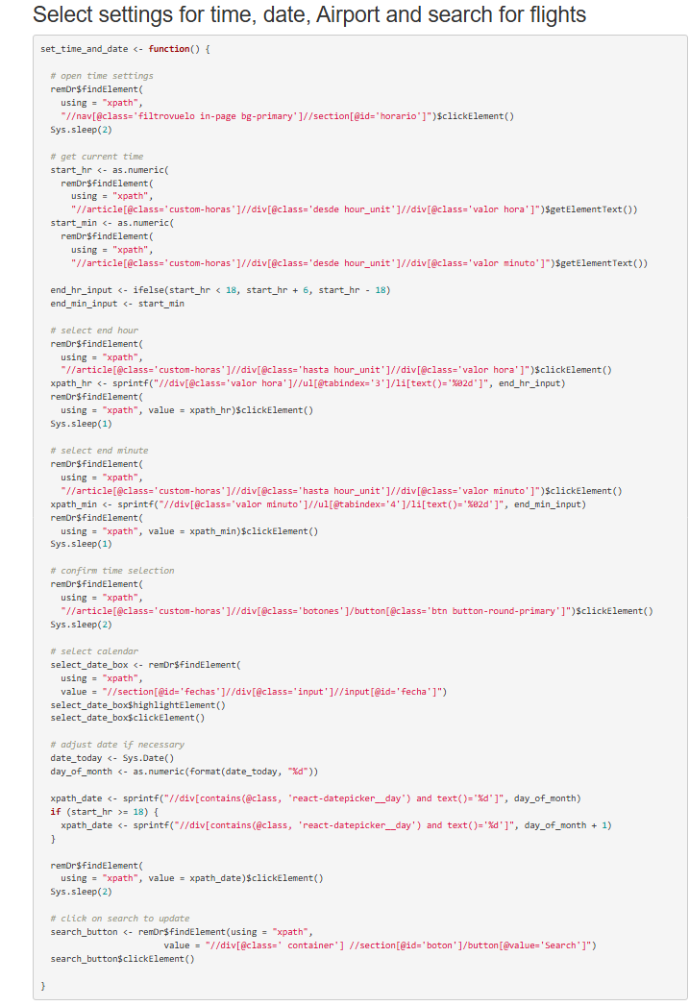
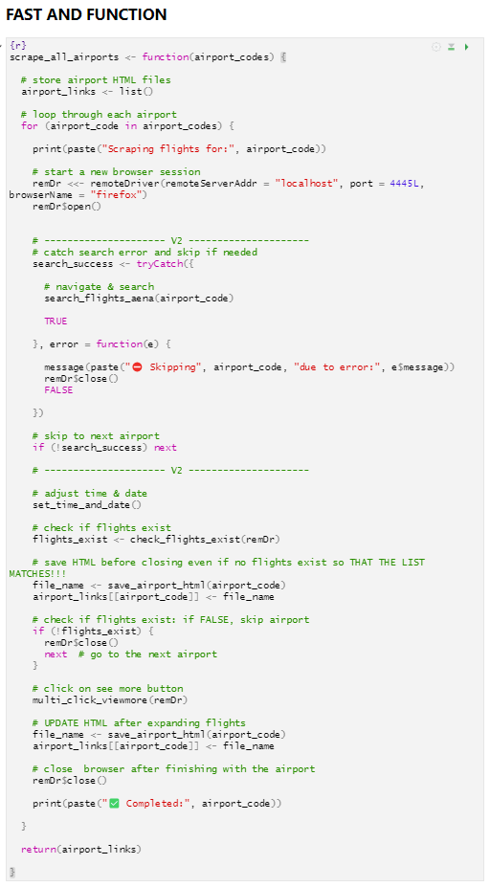
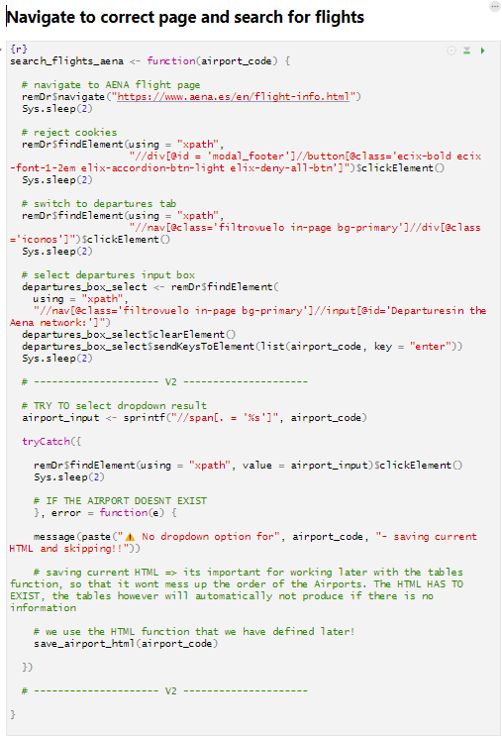
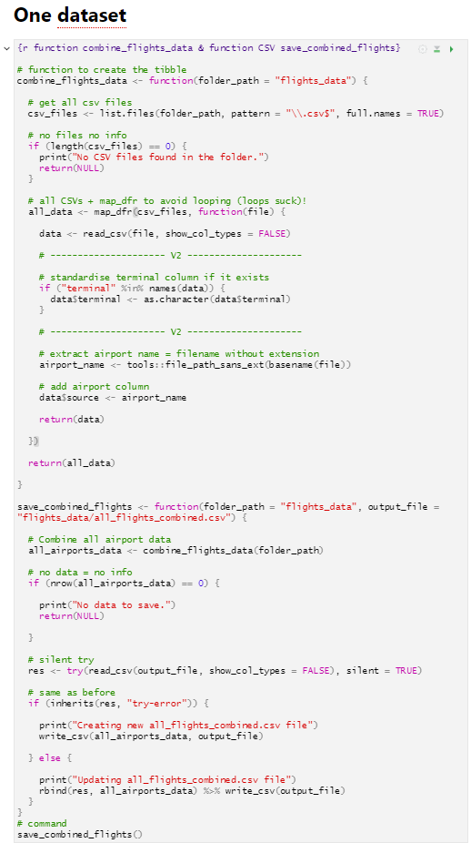
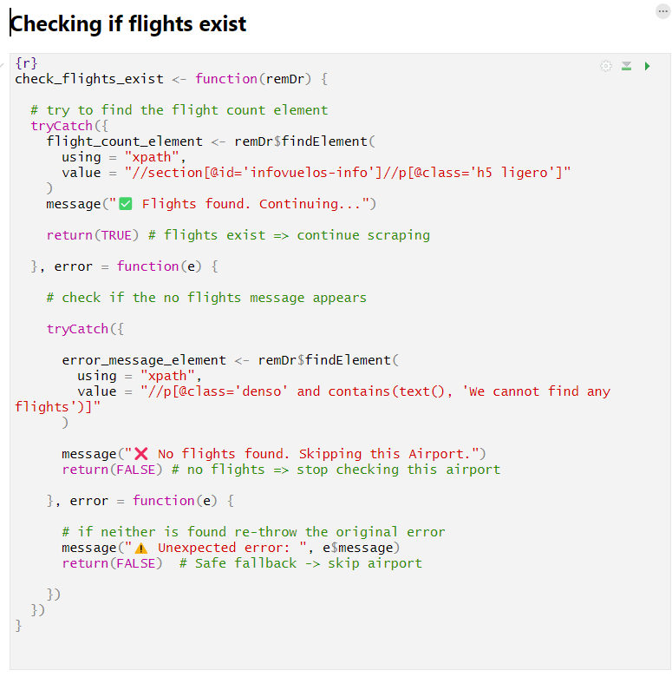
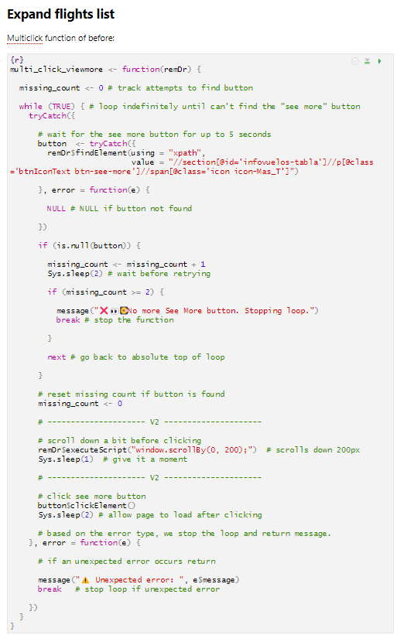
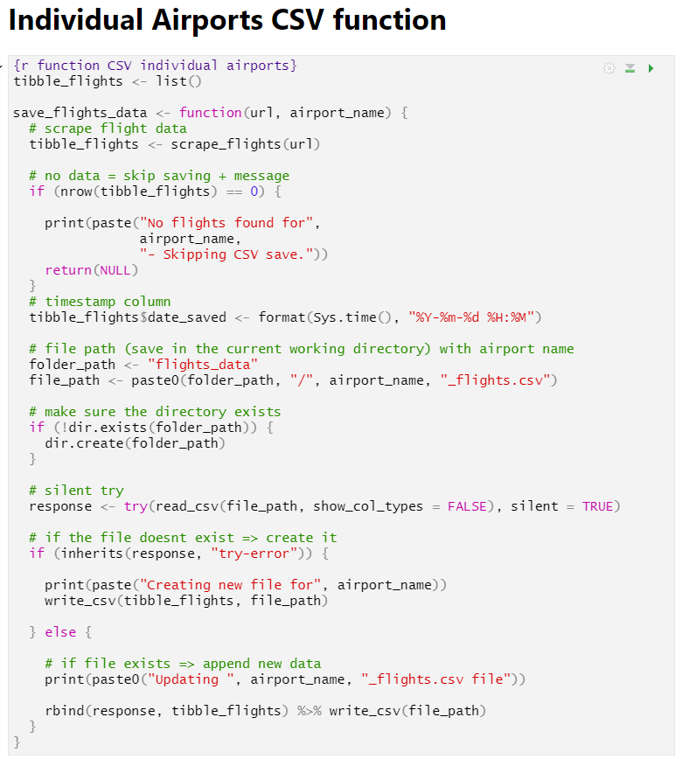

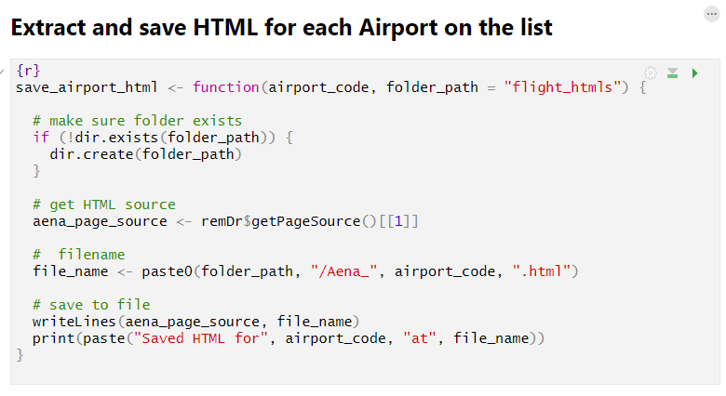
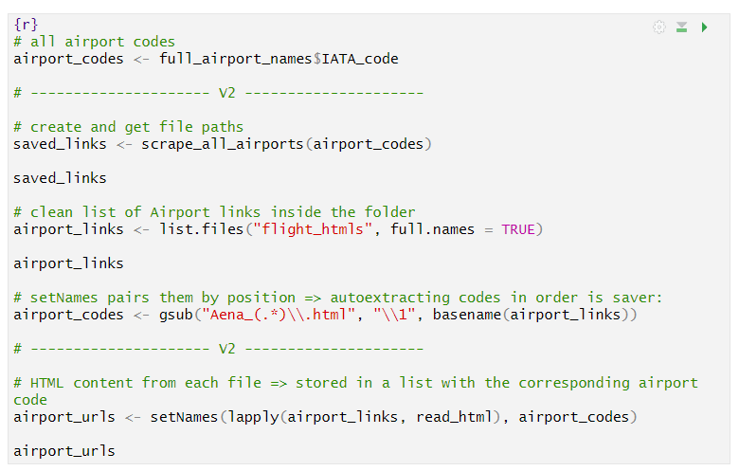
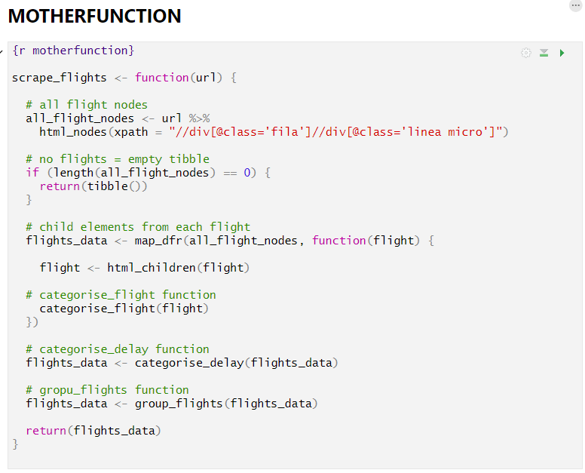
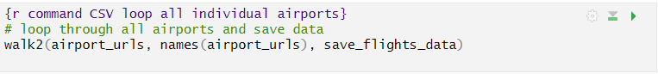


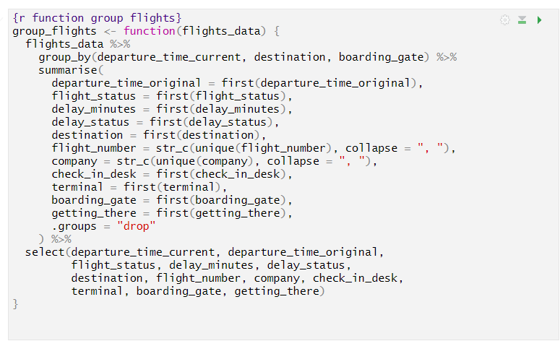
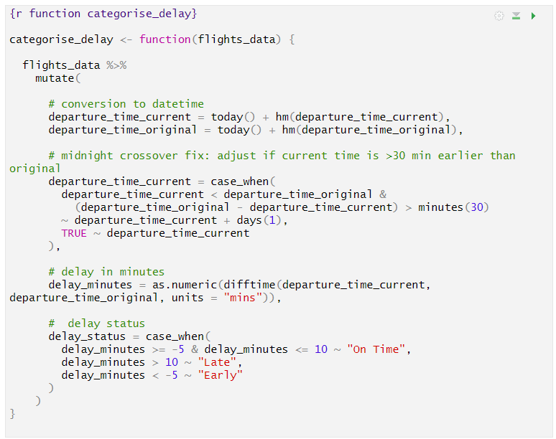
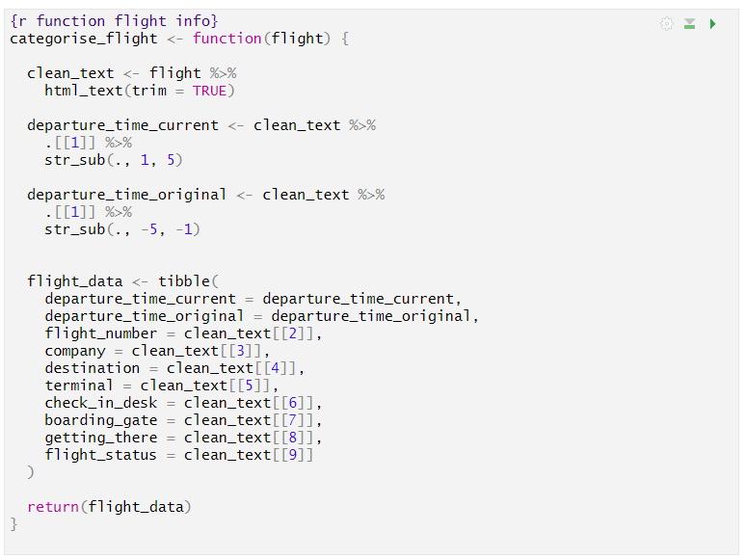
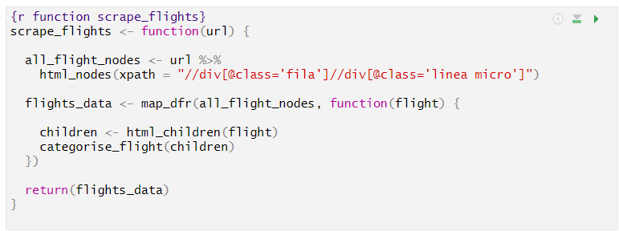
Looping
Rselenium looping: get all HTMLs
Fast and Function
Connect with airport search table
Table looping: scrape and process the information into tables
Motherfunction
One big dataset
=> For ALL 48 AIRPORTS
Notes:
5. Looping (you talk blah blah) [ADD SLIDE INPUT YOU WANT - ALSO GOOD SLIDE]

Slide 10
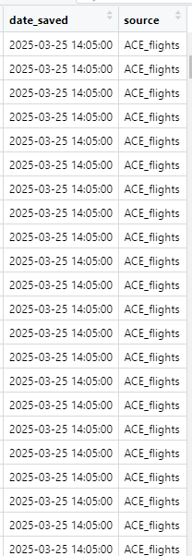
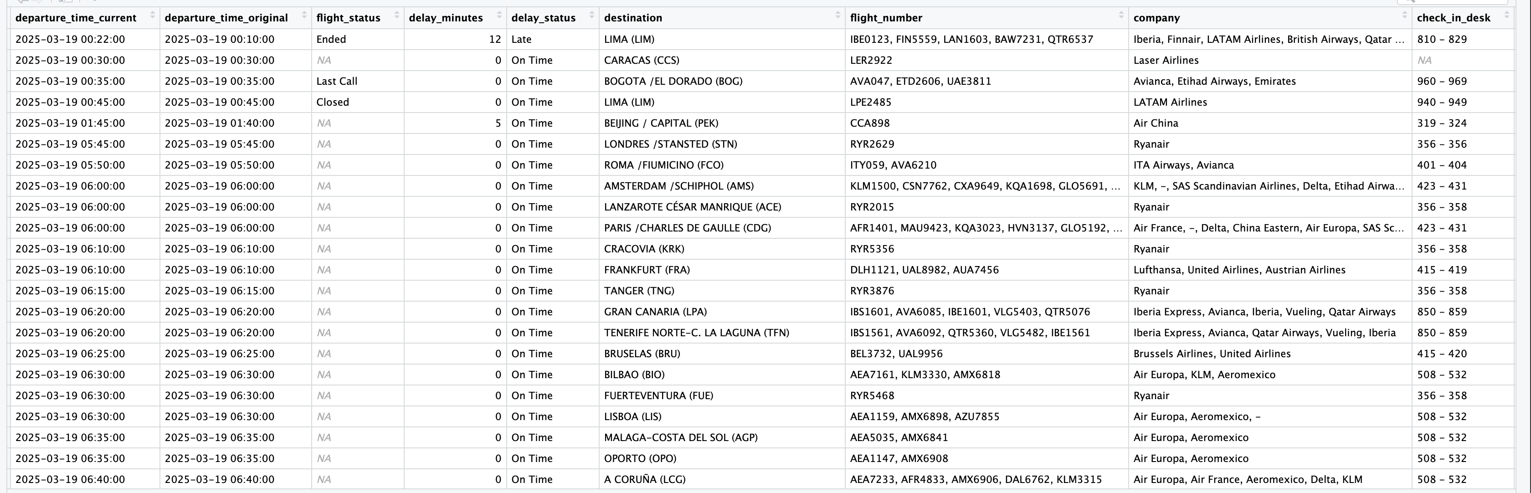
Final output Complete table with each airport’s upcoming information.
...
Notes:
6. Final output tables

Slide 11

Late challenges
Mismatch in airport list and searchable airports
Missing scroll function in Rselenium for loop
Notes:
7. Late challenges

Slide 12

Conclusion
Imperfect but happy!
Learned a lot.
Questions?
Notes:
8. Final conclusions - I think you say we are really happy with what we did but know it hasn't been perfect, we maybe got a bit ambitious connecting to the AENA airport list and trying to loop over all airports.

